Slide 1
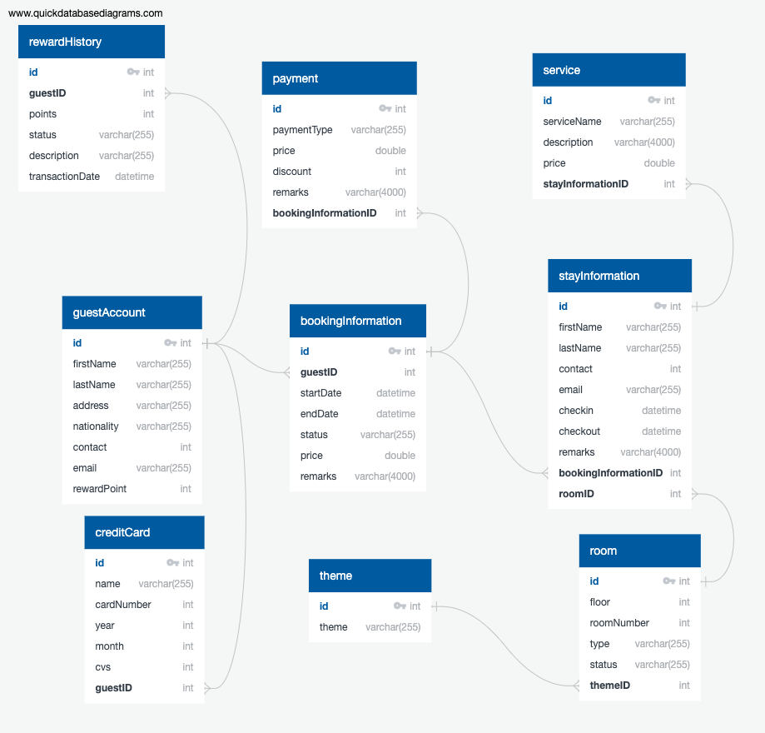
Overview of database

Slide 2
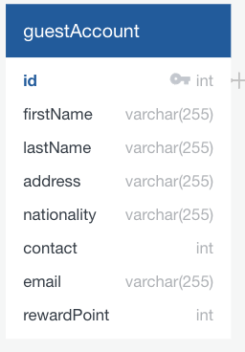
guestAccount
guestAccount table is to store details of the guest account and the points accumulated by the guest
This points system is accumulated by guest, whenever they make a stay in the hotel. Points can be exchange for different hotel services

Slide 3
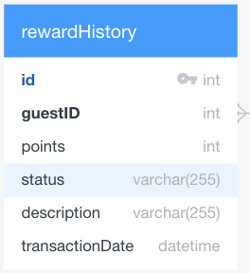
rewardHistory
rewardHistory store the information of how the guest receive the reward point or what do they spend on with their reward points

Slide 4
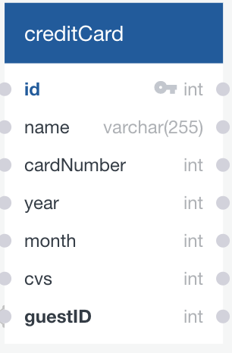
creditCard
creditCard table is to store credit card information of the guest

Slide 5
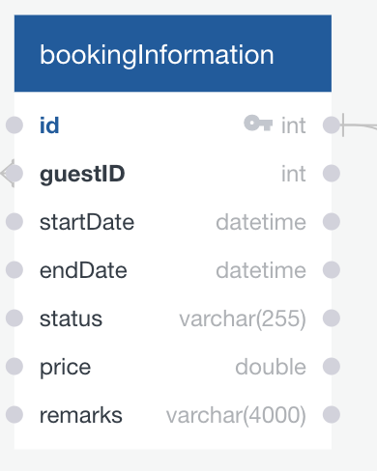
bookingInformation
bookingInformation shows the booking details which the guest booked
Remarks can be when guest is making their reservation they can try to add additional request, so the stuff may prepare before hand can be like a birthday surprise

Slide 6
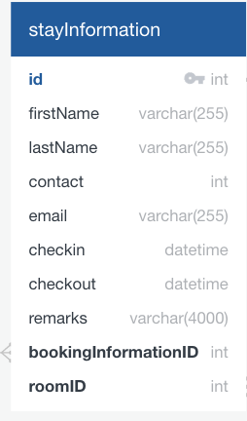
stayInformation
stayInformation records the details of the guest who are staying in the room and the room is assigned to them by the roomID
Remarks field can be what the guest feel about the stay for the room they are staying in

Slide 7
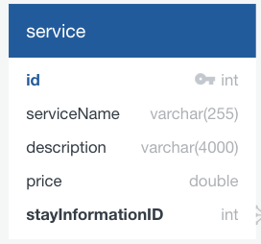
service
Service table store the information of the services the guest uses, can be like room service, spa, buffet in the hotel
Example of serviceName is spa, room service
Description will store information like example: serviceName is spa, description will be which spa package guest chooses
serviceName is Room service would be what food the guest ordered as the description

Slide 8
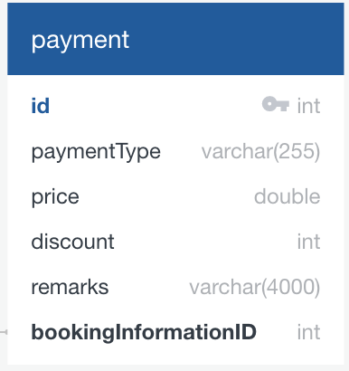
payment
Payment table store the overall price of the booking and services the guest user throughout their stay
Remarks can be reason for the discount or reason some of the items is waived off from the overall price

Slide 9
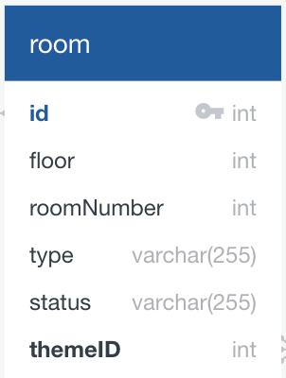
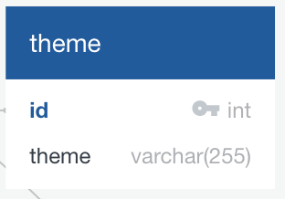
room and theme
Room table store basic information of room and what theme is the room currently having.
Theme value like Chinese new year theme room, Christmas theme room

